Slide 1
Shiny in Production
January 2019

Slide 2
Shiny in Production
RStudio 2019 Shiny Updates
Demo Development Concepts from RStudio Conference
Data Ingestion Ideas

Slide 3
RStudio 2019
Heavy emphasis on R and Shiny in Production
Sales effort focused on RStudio Connect ($15k/year)
Revised Shiny development best practices

Slide 4
Shiny Development Best Practices
1. Benchmark
4. Optimize
Done!
2. Analyze
3. Recommend

Slide 5
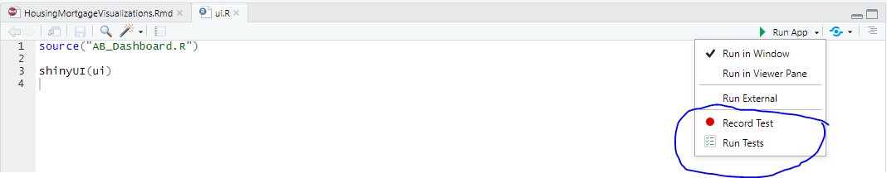
What's in a Benchmark?
Model: Representative user actions
Metrics: Latencies experienced by model user
1. Benchmark
4. Optimize
Done!
2. Analyze
Shinytest: Requires RStudio 1.2.x
3. Recommend

Slide 6
Analysis
Exercise model to produce metric data
Identify the slowest thing – one at a time!
Optimizing slowest thing gives highest payoff
Rprof and profvis (profvis calls base Rprof)
“Feels slow” usually means R is busy
Rprof: sample what R is doing
Computing (ggplot2, dplyr)
Waiting (database, network, disk)
profvis: visualize Rprof output
1. Benchmark
4. Optimize
Done!
2. Analyze
3. Recommend
Notes:
See profvis_demo.R

Slide 7
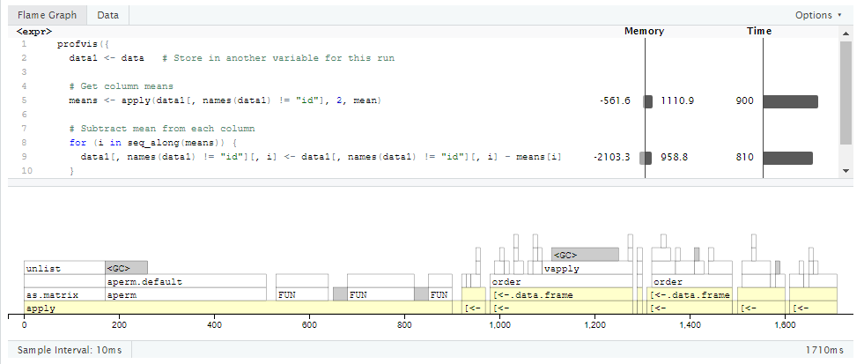
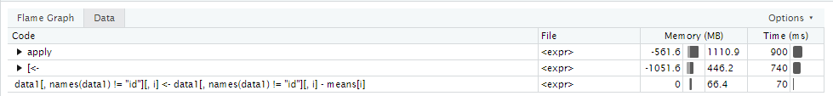
Analysis - profvis

Slide 8
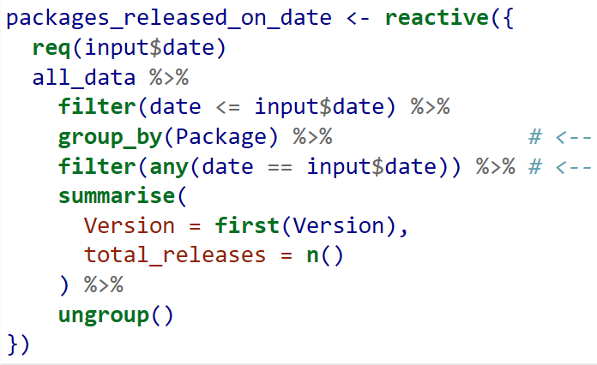
Optimize
Plot caching
Code optimization
If data is large, preprocess!
group_by → filter = slow (filter first!)
1. Benchmark
4. Optimize
Done!
2. Analyze
3. Recommend
Notes:
See profvis_demo.R

Slide 9
Optimize, cont’d
Plot caching
Code optimization
Read_csv much faster than readRDS!
Plot Caching
1. Benchmark
4. Optimize
Done!
2. Analyze
3. Recommend
Notes:
See profvis_demo.R

Slide 10
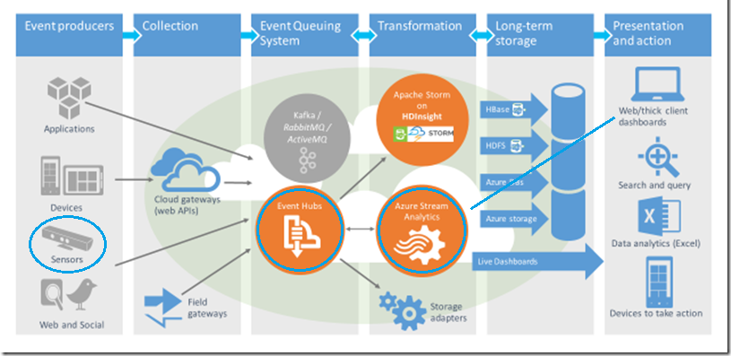
Data Ingestion - Azure
Realtime sensors → Event Hub → Stream analytics → Shiny

Slide 11
Data Ingestion - BigQuery

Slide 12

Production Shiny
Ready for the next 10,000 viewers

